Slide 1
Code For ...
Comparing recursive, and iterative
Kyo-Min Hwang
Chae-Eun Hwang
Hyo-Bin Hwang
Notes:
Hello World
<숫자>

Slide 2
Contents
Problem
Solutions
Impression
Notes:
<숫자>

Slide 3
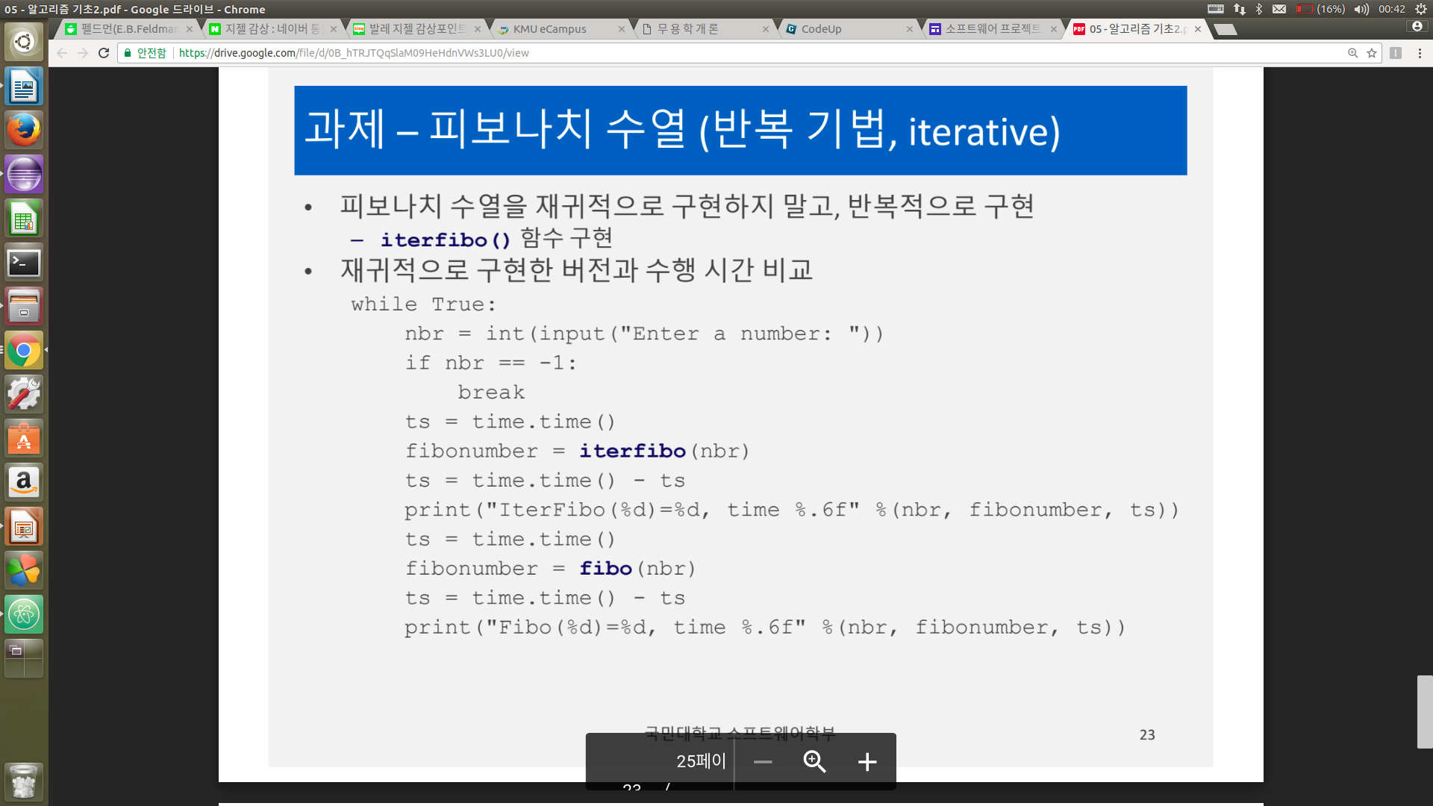
1. Problem
Notes:
<숫자>

Slide 4
2. Solution(before)
def iterfibo(n):
a = 1
b = 1
if n == 0 :
a = 0
elif n == 1 or n == 2:
a = 1
else :
for i in range(n - 1):
x = b
b = a + x
a = x
return a
def iterfibo(num):
fib = [0,1]
if num <= 1:
return num
else:
for i in range(2,num + 1):
fib.append(fib[i-1] + fib[i - 2])
return fib[-1]

Slide 5
Solutions(after)
def iterfibo(n):
if n == 0 :
return 0
else :
a = 1
b = 1
temp = 0
for i in range(n - 2):
temp = a + b
a = b
b = temp
return b
def iterfibo(num):
try :
fib = [0,1]
for i in range(2,num + 1):
fib.append(fib[i-1] + fib[i - 2])
return fib[num]
except:
return num
case를 간단하게 함.
Return 문을 하나로 만들고, -5같은 것들에 대한 처리를 추가.

